Slide 1
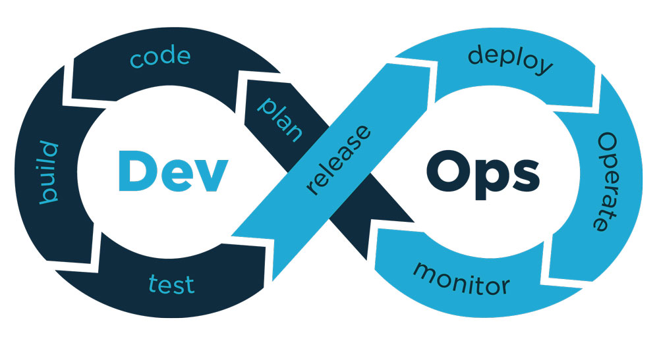
DevOps Engineer

Slide 2
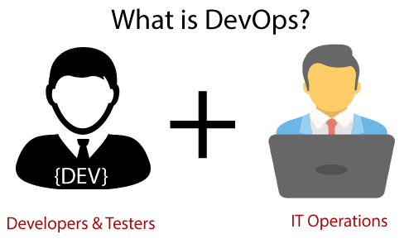
DevOps is a software development strategy which bridges the gap between Development and Operations team to deploy code to production faster in an automated & repeatable way.
i.e to resolve an issue or problem between development and operation tea.

Slide 3
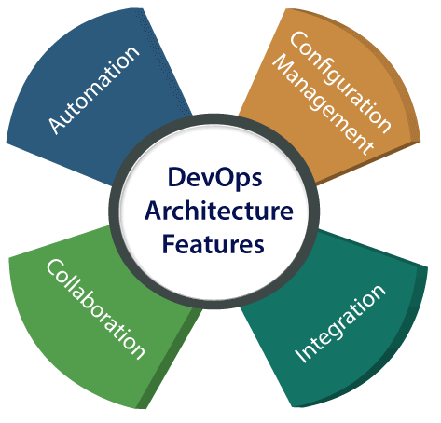
DevOps Architechture
Automation:
Automation can reduce time consumption, especially during the testing and deployment phase. The productivity increases, and releases are made quicker by automation. This will lead in catching bugs quickly so that it can be fixed easily.

Slide 4
Collaboration:
The Development and Operations team collaborates as a DevOps team, which improves the cultural model as the teams become more productive with their productivity
Integration:
Applications need to be integrated with other components in the environment. The integration phase is where the existing code is combined with new functionality and then tested. Continuous integration and testing enable continuous development. The frequency in the releases and micro-services leads to significant operational challenges.

Slide 5
Configuration management :
It ensures the application to interact with only those resources that are concerned with the environment in which it runs. The configuration files are not created where the external configuration to the application is separated from the source code. The configuration file can be written during deployment, or they can be loaded at the run time, depending on the environment in which it is running.

